Slide 1
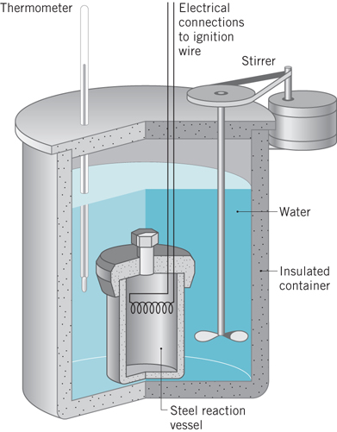
Energy is the Reason for Everything
Calorimetry – measurement of a thermodynamic quantity through the generation of a temperature difference
C₈H₁₄O₂ + 21/2 O_{2(g)} 8 CO_{2(g)} + 7 H₂O_{(l)}
Bond enthalpy released as heat
Heat moves from high temperature
To low temperature water
q_{rxn} = m x C_{s} x ∆T
m = mass of water in calorimeter
C_{s} = water specific heat capacity
Using a calorimeter
+
Enthalpy of reaction
system
surroundings
General chemistry question – what other thermo quantities can we measure using a calorimeter?
Slide 1

Slide 2
We Always Make Assumptions When We Describe Experiments and Results
q_{rxn} = m_{H2O} x C_{s H2O} x ∆T
All of the q_{rxn} has gone into the H₂O.
What besides the H₂O absorbed heat and changed temperature?
The energy measured is from the reaction we want to study.
What else is generating energy?
There is no energy exchange between the calorimeter and the lab environment.
Our measurement equipment is error free.
ALWAYS ACKNOWLEDGE YOUR ASSUMPTIONS!!
They limit the validity of your results
How big are the errors from these assumptions?
Do the errors invalid your results?
Can we correct the errors in these assumptions?
Assume makes an ass of u and me
What assumptions have we made?
True?
True?
True?
True?
Slide 2

Slide 3
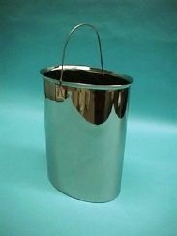
Can We Correct the Errors
Produced by Our Assumptions?
What besides the water is absorbing heat and changing temperature?
You can measure each individual contributor and sum them up.
ASSUME that you’ve accounted for them all.
OR Calibrate the entire apparatus using a known compound
?
Methyl salicylate
Fewer assumptions about the apparatus
Data always trumps assumptions
What errors are we introducing during calibration?

Slide 4
Accuracy and Precision
Random Error and Systematic Error
What’s the difference between precision and accuracy?
Precision – repeatedly do the same thing?
Accuracy – how close are you to the correct value
Requires that you know the right answer!
Not the right thing
Run controls
Random error
Systematic error
Not Accurate not Precise
Accurate Not Precise
Precise &
Accurate
Precise Not Accurate
Instrument calibration and random error:
If you only run 1 calibration experiment, and use the data
Will that result in a random or systematic error in the rest of your data?
Does it matter?
Bias
Comparing 2 numbers referred to an arbitrary point?

Slide 5
What Do We Want To Measure?
What Are We Measuring?
C₈H₁₄O₂ + 21/2 O_{2(g)} 8 CO_{2(g)} + 7 H₂O_{(l)}
+
Enthalpy of reaction
Anything in the bomb that reacts with oxygen!
What else is in your sample?
Starting materials chlorobutyronitrile / cyclohexyl chloride?
Butanol / methanol? What’s your GC look like? IR?
Carboxylic acid? What’s your IR look like?
Unwanted side products?
Contaminants? Silicon grease? Dirty glassware?
Fe wire oxidizing!
How much?
Can we compensate for the impurities?
What else?
Water?
In analytical chemistry, there’s no such thing as “zero”.

Slide 6
What Are We Measuring
with Reaction Enthalpy?
Our 2 reaction products have the same empirical formula
C₈H₁₄O₆
And the same number of each type of bonds
C-H C=O C-C C-O
If they’re both react to produce the same products
8 CO₂ + 7 H₂O
Then any reaction enthalpy difference must be due to the starting the P-ester/H-ester bond enthalpy differences
High energy = unstable = reactive = higher energy released

Slide 7
What is the Source of the
Energy Difference?
Our assumption is that the only energy difference is structural, from ring strain.
P-ester
Energy
∆H⁰
H-ester
∆H⁰
Products
CO₂ & H₂O
Reaction Progress
For sp³ carbons, why are rings other than n = 6 “strained”
higher energy, less stable, more reactive?

Slide 8
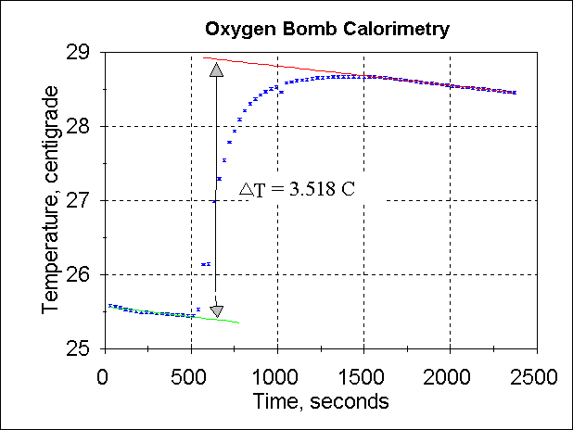
Corrections For Experimental Errors
Here’s an example of what we think your data will look like:
Why are these lines sloped?
TAKE A LOT OF POINTS!!!
Slide 8

Slide 9
Experimental Error in Science
To truly understand experimental error we need to run replicates
More is better
Occasionally we only have n = 1
A super Nova
A very expensive experiment
An undergrad lab where we don’t have unlimited time or equipment
“Propagation of error”
Every time we add a procedural step or a mathematic operation we increase - often multiple - the experimental error
Propagation of error is a formalism that reflects the formal error in procedural steps, reflected in any mathematical operation
Σ(x_{i}-x)²
n
SD =
It’s how we estimate error (~when n = 1)
Slide 9

Slide 10
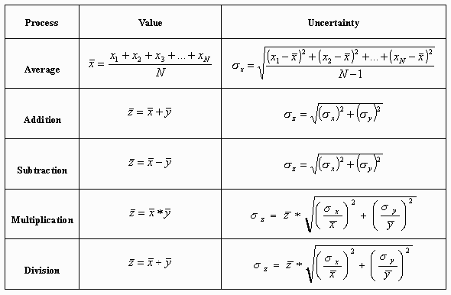
Propagation of Error in
Mathematical Operations
SD
RSD
Slide 10

Slide 11
A Warning About Volume Transfer
Volumetric flask are TC – To Contain
It will not accurately deliver a volume
Our experimental write up says that differences will average out.
What is the criteria for “averaging”?
What experimental steps violate that criteria?
The best of bad experimental options:
Speed, accuracy, precision, temperature loss
Slide 11

